Slide 1



Online Retailer Customer Segmentation
Data Science Capstone
Spring 2022 SECS 7259-01 22124
Vidya Rayanoothala

Slide 2
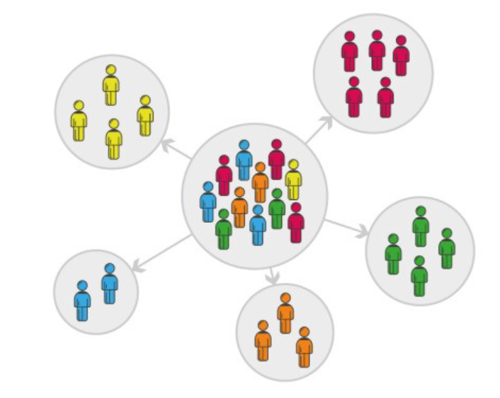
Online Retailer: Business Objective
Need to explore: E-Commerce past infancy
Maximize efficiency leads to profits
Understand customers key to success
Business Objective: Understand customer to enhance Product offering and maximize profit
Scope and Design: Customer Segmentation
Data preparation: Data Exploration, Data Cleaning
Descriptive analysis: Visuals to derive insights
Unsupervised learning model: Clustering
Dimensionality reduction
Baseline: K-Means Elbow method to find clusters
Hierarchical or Partitioning clustering or RFM Model
Model iteration and best fit
Examining with scatter plots
Evaluating model
Model Implementation
Stakeholders: Online Retailer, Customers, Support functions

Slide 3
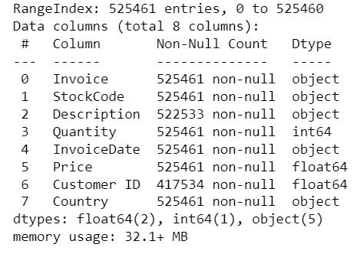
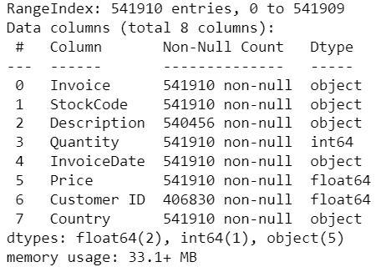
Data Acquisition
- Transactions for a UK-based and registered, non-store online retail between 01/12/2009 and 09/12/2011
- Source: Dr. Daqing Chen, Course Director: MSc Data Science. School of Engineering,
London South Bank University, London SE1 0AA, UK.
https://archive.ics.uci.edu/ml/datasets/Online+Retail+II
Reference:
https://www.kaggle.com/datasets/lakshmi25npathi/online-retail-dataset?select=online_retail_II.xlsx
Online Retail: Year 2009-10
Online Retail: Year 2010-11

Slide 4
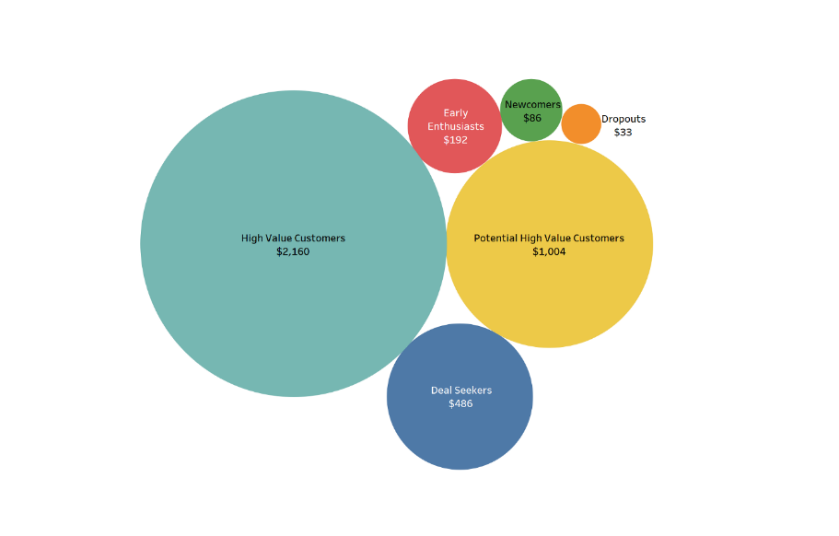
Online Retailer:
Main consumers of the model:
Online retailers looking for optimizing product offerings
Online retailers expanding into new geographic locations
Retailers exploring Online space
Risks:
Not all models are true always
Choosing the right algorithm for the job is no easy task
Data-mining complexity involved in identifying distinctive clusters
Skewness to UK impacted by Exogenous influences like Brexit, Supply chain issues

